Slide 1
1. Variables
Class name usually start with Capital letter
class Demo {
public static void main(String[] args) {
int a = 0;
}
variable name usually start with small letter

Slide 2
2. array
-Array is used to store a collection of data
int[] c; // declare a variable to reference the array
c = new int[3]; // allocate memory for 3 int
c[0]=17; // assign value
c[1]=23;
c[2]=38;
System.out.println(“0th value:“+ c[0]);
System.out.println(“1st value:“+ c[1]);
System.out.println(“2nd value:“+ c[2]);
Concatenate string

Slide 3
3. String
Alternative way to create a String object
char[] dArray = { 'h', 'e', 'l', 'l', 'o', ’X’, ‘D’, ‘D’ };
String dString = new String(dArray);
System.out.println(dString);

Slide 4
5. for-loop
Loop: program construct to control repeated execution of a block of statements
for(int i=1; i<=4; i++){
System.out.println("Count is: " + i);
}
Initial action
Loop continuation condition
Action after each iteration
The output will be:
Count is: 1
Count is: 2
Count is: 3
Count is: 4

Slide 5
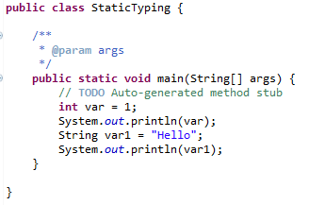
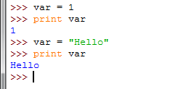
Static Typing
Java vs. Python: Java requires declaration of the variables, specifying the types of variables
The variable type stipulates: (i) the set of values that can be taken and (ii) the operations that can be performed on those values
Java is a statically-typed language
Java
Python
No declaration, variable types depend on results of assignments / program execution

Slide 6
Static Typing
Java is a statically-typed language
The types of all variables are known at compile time
Can perform type checking statically (checking before the program even runs)
In dynamically-typed languages like Python, this type checking is deferred until execution time (while the program is running)
Many ideas in this course / modern programming language is to eliminate bugs from the code, and static typing is one idea
int e1 = 24;
String e2 = "hello";
e2 = e1;
/* found before program execution */
Program in high-level programming language
Machine code / Bytecode
compile
execute
Result

Slide 7
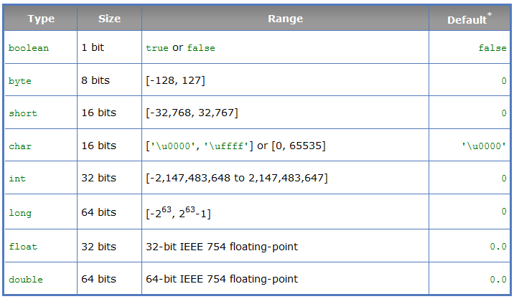
Primitive Types
int number = 0; vs int[] number = {1,2,3};

Slide 8
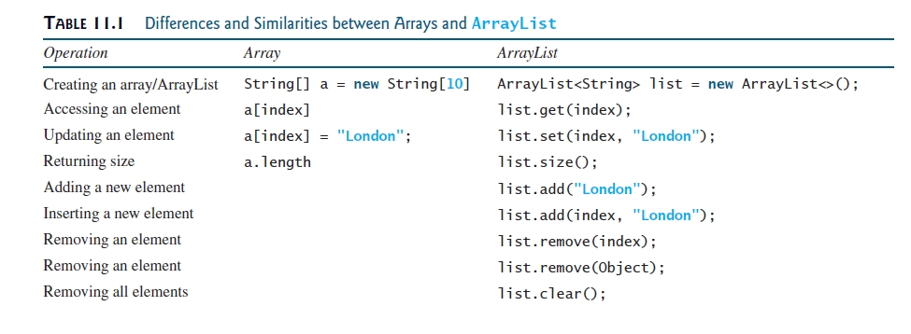
ArrayList, LinkedList

Slide 9
ArrayList, LinkedList
Operations for ArrayList and LinkedList are similar (both implemented the List interface)
Underlying mechanisms are different:
ArrayList stores elements in an array; if the capacity is exceeded, a larger new array will be created and all the elements are copied to the new array
LinkedList stores elements in a linked list data structure
Have different performance for various operations, e.g. ArrayList is more efficient to support random access through an index
Random Access:
ArrayList: 3.3ms
LinkedList: 4269ms
Insertion:
ArrayList: 1859ms
LinkedList: 13.33ms

Slide 10
Generics
Generics is a programming language design to use type as parameter
ArrayList<String> w1 = new ArrayList<String>();
ArrayList<String> w3 = new ArrayList<>();
Detect error at compile time rather than runtime, i.e., static checking
More reliable
ArrayList<String> l = new ArrayList<String>(); l.add("hello"); l.add("bye"); l.add(2); // error detect at compile time

Slide 11


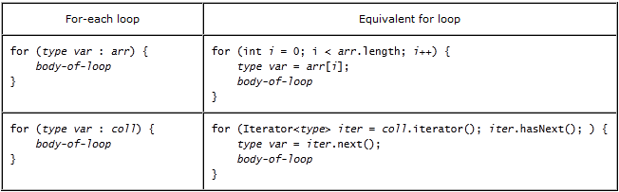
Iteration Types

Slide 12
Object-Oriented (OO) Programming
OO Programming: programming using objects
vs. procedural programming (step-by-step statements, procedure call)
Program: interaction between objects
Abstraction, encapsulation, inheritance, polymorphism
Enable development of large-scale software
Object represents an entity in the real world
A student, a desk, a circle
An object has a unique identity, state, behaviors
State / data fields / properties / attributes
Behavior / methods / action

Slide 13
Classes
Objects of the same type are defined by Class
A class is a template / contract that defines the object’s data fields and methods
An object is an instance of a class
Java variables: data fields
Java methods: behaviors
Constructors: special type of methods, invoked to construct objects from classes

Slide 14
Constructors
Special kind of methods that are invoked to create a new object (create an instance, or instantiation)
No-arg constructor: constructor without parameter
Constructor must have the same name as the class itself
No return type, not even void
Invoked with the new operator, play the role of initializing objects
A class may be defined without constructors. In this case, a no-arg constructor with an empty body is implicitly declared in the class. This constructor, called a default constructor, is provided automatically only if no constructors are explicitly defined in the class.

Slide 15
Example
Circle myCircle = new Circle(5.0);
Declaration: associates a variable with an object type
Instantiation: new operator allocates memory, returns reference to the object memory, invokes constructor
Initialization: by constructor

Slide 16
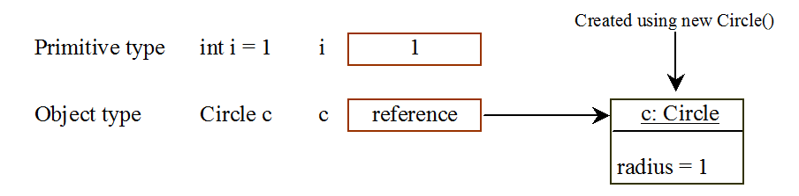
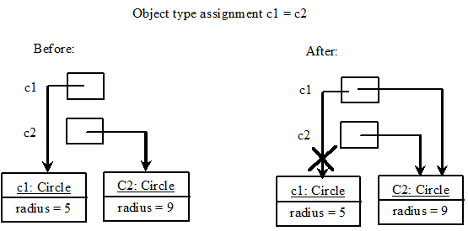
Differences between variables of primitive data types and object types
Garbage collected automatically by JVM
(assigning reference variable to null helps garbage collection)

Slide 17
Instance variables and methods
Instance variables belong to a specific instance
Instance methods are invoked by an instance of the class
Static variables, methods
Static variables are shared by all the instances of the class
Are not tied to a specific object
Use the static modifier
Static method can be called without creating an instance of the class

Slide 18
Visibility modifiers: public, private
By default, the class, variable or method can be accessed by any class in the same package (Package: organizes Java classes into namespaces)
public: visible to any class in any package
default: package private, visible only to classes in the same package
private: visible only by the declaring class

Slide 19
Why put data fields private
To protect data
client can tamper the classes / objects
To make class easy to maintain
impose class constraints / invariants
Data Field Encapsulation
Keep attributes private, if possible
Use get method (getter / accessor) to return the values of attributes, e.g., double getRadius()
Use set method (setter / mutator) to update attributes, e.g., void setRadius(double radius)()
Design principles:
Minimize the accessibility of classes and members
In public classes, use accessor methods, not public attributes

Slide 20
Passing objects to methods
Java: only pass-by-value
Primitive type: value is passed (i.e. putting int as the parameter will not change int)
Reference type: value (reference to an object) is passed

Slide 21
Inheritance
Inheritance
Programming constructs to allow inheriting code from one class (superclass) to another class (subclass)
Enables you to define a general class (superclass) and later extend it to more specialized classes (subclass)
Example: GeometricObject, Circle
Class Circle extended from Class GeometricObject
Use keyword extends
Superclass / parent class / base class
Subclass / child class / derived class / extended class
Subclass inherits all accessible data fields and methods from the superclass, except constructors

Slide 22
Advantage of inheritance
Avoid redundancy
Different classes may have common properties and behaviors
Easy to maintain
Easy to comprehend
Class relationship documented in the inheritance tree
Extra
Java allows only single inheritance: A Java subclass inherits only from one superclass (multiple inheritance can be achieved through interface

Slide 23
super
Superclass’s constructors are not inherited
Invoked explicitly or implicitly using super keyword
If the keyword super is not explicitly used, the superclass’s no-arg constructor is automatically invoked
If neither is invoked explicitly, the compiler puts super() as the first statement in the constructor
Note this is always going to super the no-args constructor
Call to constructors (this() / super()) must be the first statement in the constructor
Constructing an instance of a class invokes all the superclasses’ constructors along the inheritance chain

Slide 24
Overriding Methods
Sometimes it is necessary for the subclass to modify the implementation of a method defined in the superclass
An instance method can be overridden only if it is accessible. Thus a private method cannot be overridden, because it is not accessible outside its own class. If a method defined in a subclass is private in its superclass, the two methods are completely unrelated.
You can only override instance methods. You can hide instance attributes / static methods / static attributes (overriding vs. hiding)

Slide 25
Polymorphism, Dynamic Binding
public class PolymorphismDemo {
public static void main(String[] args) {
m(new GraduateStudent());
m(new Student());
m(new Person());
m(new Object());
}
public static void m(Object x) {
System.out.println(x.toString());
}
}
class GraduateStudent extends Student {
}
class Student extends Person {
public String toString() {
return "Student";
}
}
class Person extends Object {
public String toString() {
return "Person";
}
}
Method m takes a parameter of the Object type. You can invoke it with any object.
An object of a subtype can be used wherever its supertype value is required. This feature is known as polymorphism.
When the method m(Object x) is executed, the argument x’s toString method is invoked. x may be an instance of GraduateStudent, Student, Person, or Object. Classes GraduateStudent, Student, Person, and Object have their own implementation of the toString method. Which implementation is used will be determined dynamically by the Java Virtual Machine at runtime. This capability is known as dynamic binding.
Every instance of a subclass is also an instance of its superclass, but not vice versa (e.g., Person is an Object)

Slide 26
Dynamic Binding
Dynamic binding works as follows: Suppose an object o is an instance of classes C₁, C₂, ..., C_{n-1}, and C_{n}, where C₁ is a subclass of C₂, C₂ is a subclass of C₃, ..., and C_{n-1} is a subclass of C_{n}. That is, C_{n} is the most general class, and C₁ is the most specific class. In Java, C_{n} is the Object class.
*If o invokes a method p, the JVM searches the implementation for the method p in C₁, C₂, ..., C_{n-1} and C_{n}, in this order, until it is found. Once an implementation is found, the search stops and the first-found implementation is invoked.
E.g., Circle is an Object

Slide 27
Casting Object
Casting can be used to convert an object of one class type to another within an inheritance hierarchy. In the preceding section, the statement
m(new Student());
assigns the object new Student() to a parameter of the Object type. This statement is equivalent to:
Object o = new Student(); // Implicit casting
m(o);

Slide 28
Down-casting
Casting from superclass to subclass
Explicit casting must be used when casting an object from a superclass to a subclass. This type of casting may not always succeed.
Object y = new Circle();
Circle x = (Circle)y;
(Declared type vs actual type)

Slide 29
The instanceof Operator
Use the instanceof operator to test whether an object is an instance of a class:
Object myObject = new Circle();
... // Some lines of code
/** Perform casting if myObject is an instance of Circle */
if (myObject instanceof Circle) {
System.out.println("The circle diameter is " +
((Circle)myObject).getDiameter());
...
}

Slide 30
The protected Modifier
The protected modifier can be applied on data and methods in a class. A protected data or a protected method in a public class can be accessed by any class in the same package or its subclasses, even if the subclasses are in a different package
private, default, protected, public

Slide 31
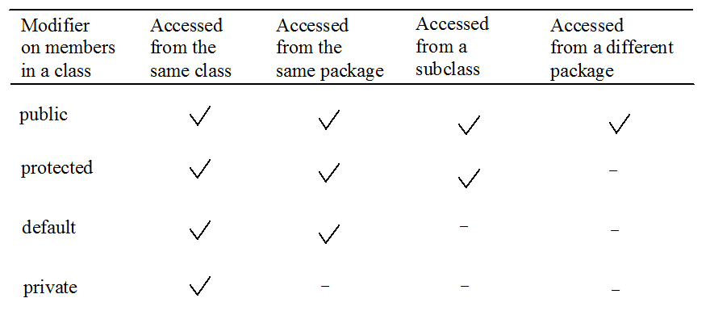
Visibility Modifiers

Slide 32
A Subclass Cannot Weaken the Accessibility
A subclass may override a protected method in its superclass and change its visibility to public. However, a subclass cannot weaken the accessibility of a method defined in the superclass. For example, if a method is defined as public in the superclass, it must be defined as public in the subclass

Slide 33
Abstract Class
Cannot create instance of abstract class using the new operator
(however, anonymous classes made from abstract)
An abstract method is defined without implementation
Means no body, but CAN still have parameters!!
Implementation provided by subclass
A class that contains abstract methods must be defined as an abstract class
Practical advantage of abstract class: generic programming
public static boolean equalArea(GeometricObject o1, GeometricObject o2){
return o1.getArea() == o2.getArea()

Slide 34
Interface
Interface is a class-like programming construct that contains only constants and abstract methods
In many ways similar to abstract class, as we will see
But its intent is to specify common behavior / characteristics of objects of related classes or unrelated classes, e.g., comparable, eatable, etc

Slide 35
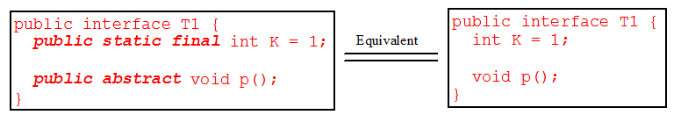
Interface
In interface, since all data fields are public static final and all methods are public abstract, these modifiers are ok to be omitted
Similar to abstract class:
Cannot create an instance from an interface using the new operator
Ok to use an interface as a data type for a variable
Use it for casting
etc

Slide 36
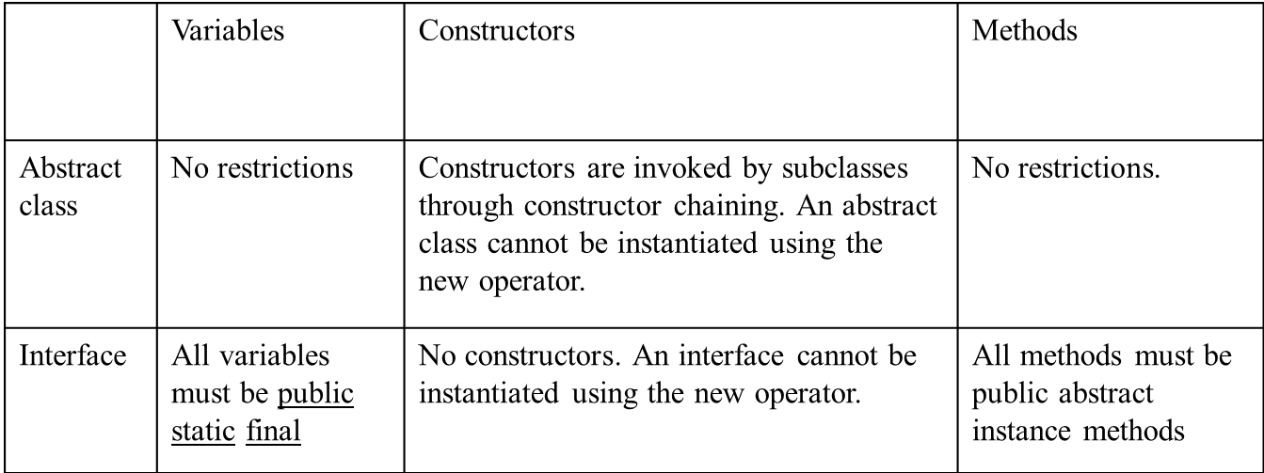
Abstract Class vs. Interface
Interface: all data must be constants
Abstract class: all types of data
Interface: all methods are abstract (signature only)
An abstract class can have concrete methods

Slide 37
Abstract Class vs. Interface
All classes share the same root, Object; but there is no single root for interfaces
Like a class, a variable of an interface type can reference any instance of the class that implements the interface
If a class implements an interface, this interface plays the similar role as a superclass

Slide 38
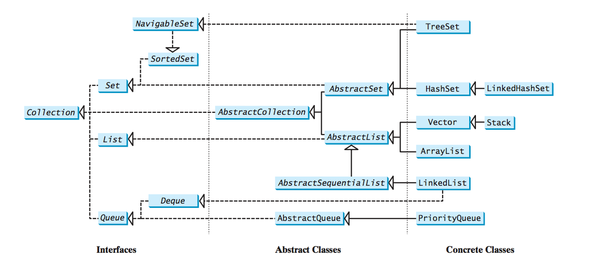
Java Collection Framework

Slide 39
Comparable Interface
Suppose you want to design a generic method to sort the objects of the same type: circles, rectangles, students, fruits
We need common behavior for the objects: comparable
Java provide the Comparable interface for this purpose
Classes that implement the Comparable interface become comparable

Slide 40
Comparable interface example
class Circle extends GeometricObject implements Comparable<Circle>{
private double radius = 1;
Circle() {
}
Circle (double radius) {
this.radius = radius;
}
public int compareTo(Circle c){
if (this.radius > c.radius)
return 1;
else if (this.radius == c.radius)
return 0;
else
return -1;
}
}

Slide 41
Comparator Interface
Comparator interface can be used to:
Provide addition way of ordering
Comparable<E>.compareTo() defines the “natural” ordering for E
Comparator<E>.compare() defines additional, alternative ordering for E
Enable comparison for objects which their classes do not implement comparable

Slide 42
Comparator Interface Example
Allow Integer to be ordered based on their absolute value
public class IntegerAbsComparator implements Comparator<Integer> {
public int compare(Integer a, Integer b) {
if (Math.abs(a) > Math.abs(b))
return 1;
else if (Math.abs(a) == Math.abs(b))
return 0;
else
return -1;
}
}
// code skip
Collections.sort(l, new IntegerAbsComparator());

Slide 43
Exception handling
When there is an exception, either the method handles it itself, or let the caller handle it
Some code: throw new Exception();
In the try block: code that is executed in the normal circumstance
In the catch block: code that is executed during the exception
Then, the statement after the catch block is executed

Slide 44
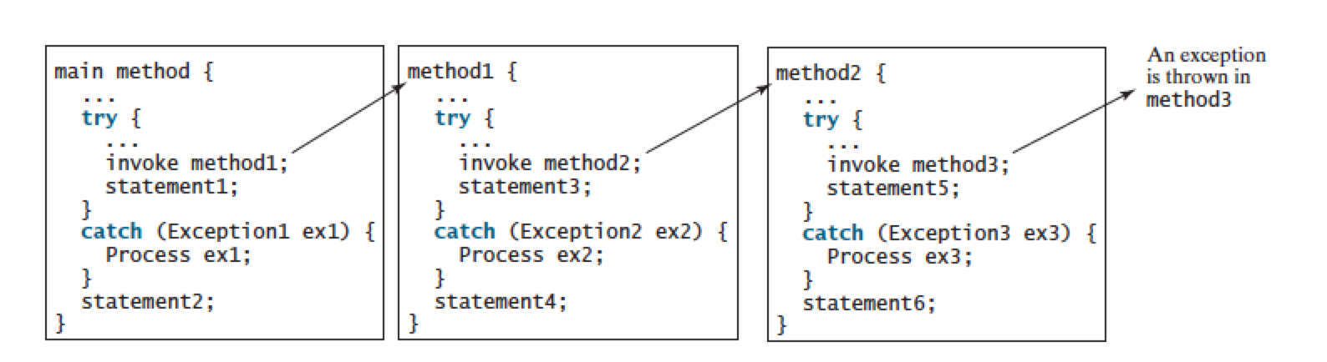
Exception handling
Method 3 throws:
Exception3: statement6, 3, 4, 1, 2
Exception2: method2 aborts, statement4,1,2
Exception1: mehtod1 aborts, statement2
If exception is not caught, program terminates, no statement executed

Slide 45
Exception types
Exceptions are objects
Root class for exception is Throwable
Error: system error, not much you can handle; e.g. VirtualMachineError occurs when system runs out of resource

Slide 46
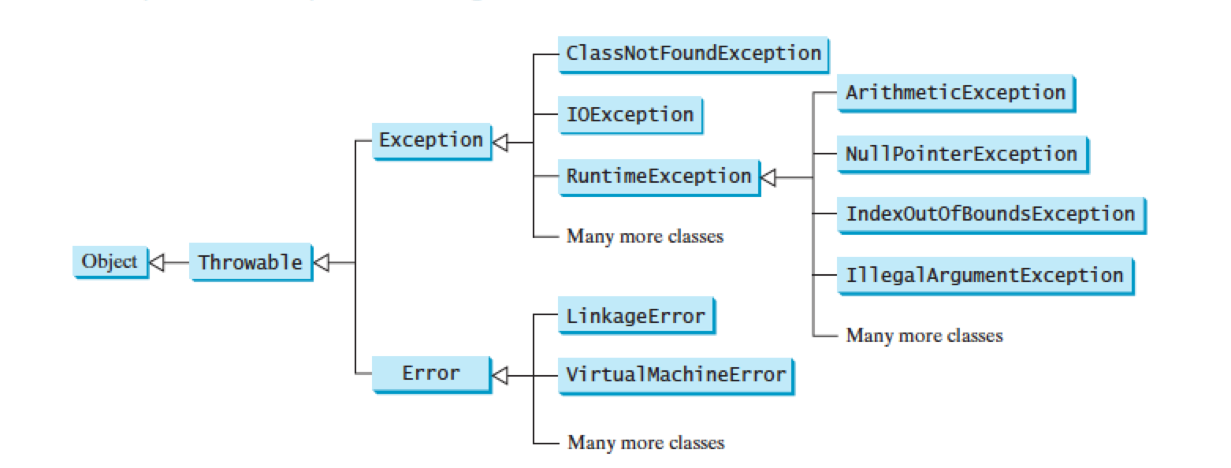
Exception types
Unchecked exception: Error, RuntimeException and their subclasses

Slide 47
Checked and unchecked exception
RuntimeException, Error and their subclasses are unchecked exception
All other are checked exception
Checked exception: compiler forces the programmer to explicitly check and handle them in a try-catch block, or declare in the method header to let caller handle (use throws)
Unchecked exception, e.g., ArithmeticException, can occur anywhere in the program

Slide 48
The finally clause
The finally clause is always executed regardless if an exception occurs or not, and if the exception is caught or not
“If you put a return, break, continue or any other java keyword that changes the sequential execution of code inside the catch block (or even try block), the statements inside the finally block will still be executed.”
Use case: file closing, clean up

Slide 49
What are design patterns?
How people have organized / designed their program in the past
Best software design solutions that others have encountered
Improve performance
Make it easier to modify the code
Can apply the same principle to your own software design
Solutions to common recurring problems in software design
One of the most valuable tools for developers / software designers

Slide 50
Singleton
To ensure there is only one instance of an object, available to a number of other classes
public class Singleton {
private static Singleton instance= null;
private Singleton(){
}
public static Singleton getInstance(){
if (instance == null)
instance = new Singleton();
return instance;
}
}
-Private constructor
-Lazy instantiation: create the instance only when it is used

Slide 51
Observer
Useful when you are interested in the state of an object and want to get notified whenever there is any change
Subject (Publisher) maintains a list of its dependents (observers / subscribers)
Subject notifies them automatically of any state changes
GoF: “Define a one-to-many dependency between objects so that when one object changes state, all its dependents are notified and updated automatically.”
A behavioral pattern: form relationships between objects during execution at runtime

Slide 52
Observer Design Pattern
Subject
Observer
+register(Observer)
+unregister(Observer)
+notifyObservers()
+update()
update()
ConcreteObserver
ConcreteSubject
ConcreteObserver( Subject s):
s.register(this)
+observerList
notifyObservers():
for (Observer o: observerList)
o.update()

Slide 53
Subject.java
public interface Subject {
void register(Observer o);
void unregister(Observer o);
void notifyObservers();
}
register: call to add a new observer
unregister: call to remover the observer
notifyObservers: inform all registered observers when state change occurs
Observer.java
public interface Observer {
void update(String msg);
}
update: call by Subject to inform Observer a change in state. Different classes of Observer can implement this different to respond to the change in state.

Slide 54
Visitor
Useful if you need to perform operations across a diverse set of objects
GoF: “Allows for one or more operation to be applied to a set of objects at runtime, decoupling the operations from the object structure”
Provide additional functionality to a class without changing it

Slide 55
Visitor Design Pattern
public interface Visitor {
void visit(Book b);
void visit(CD c);
void visit(Clothing c);
}
Different visit methods for different object types to be processed
Later, use method overloading to pick the method for processing (instead of if-then-else)
public interface Visitable {
void accept(Visitor v);
}
Allows the Visitor to be passed in

Slide 56
Item implements Visitable
class Book implements Visitable {
private double weight;
public void accept(Visitor v) {
v.visit(this);
}
public Book (double weight) {
this.weight=weight;
}
public double getWeight() {
return weight;
}
}
Simple but important change to make a class visitable:
dispatch of visit depends on data type “this”

Slide 57
Testing visitables
ArrayList<Visitable> items = new ArrayList<Visitable>();
PostageVisitor postage = new PostageVisitor();
items.add(new Book(1));
items.add(new CD("psy"));
items.add(new Book(2));
items.add(new Clothing(10));
for (Visitable o: items){
o.accept(postage);
}
System.out.println(postage.getTotal());
Visitor postage visits each item one by one, processes them, information kept inside visitor

Slide 58
Advantage of Visitor
Separate out certain logic (e.g., postage calculation) from the items themselves, keeping the item classes simple
Item classes only need to implement Visitable
Add methods to classes: another concrete class implements Visitor
No need to change item classes
Enable static checking: code cannot be compiled without the visit method of the corresponding type

Slide 59
Logic and Truth Table
Logical conjunction (AND, p ᴧ q, p . q)
Logical disjunction (OR, p ᴠ q, p + q)
Logical implication (p implies q, if p then q, p →q)
p | q | p→q
T | T | T
T | F | F
F | T | T
F | F | T

Slide 60
DPLL: Classic SAT algorithm
Key idea: unit propagation on top of backtracking search
If a clause contains one literal, set that literal to true
Necessary for any satisfiable assignment

